Slide 1


The Four Basketeers
MS5106 Data Science and Big Data Analytics
MSc. Business Analytics

Slide 2
AGENDA
01
02
INTRODUCTION
BASKET ANALYSIS
03
04
CUSTOMER SEGMENTATION
INVENTORY MANAGMENT
TEAM
Alexsandro Acha Zanella | 19233012
Varun Dua | 19230587
Xiuhong Qian | 19234716
Zi Zheng Wong | 19233546
Project Goals
Affinity Analysis
RFM Analysis
Value and Frequency
Categories
Inventory
Flow Time
Throughput

Slide 3
INTRODUCTION
Basket Analysis
Customer Segmentation
Inventory Management
Seeks to find relationships between purchases.
Dividing customers into groups based on common
Detailed record of each new/returned product as it enters or leaves a POS System

Slide 4

BASKET ANALYSIS
Affinity Analysis
An unsupervised technique of data mining to discover co-occurring relationships among activities that are carried out by certain groups or individuals.
- if you buy a certain group of items, you are more (or less) likely to buy another group of items
y

Slide 5
Frequent Item Sets
BASKET ANALYSIS
Typically refers to a set of items that often appear together in a transactional data set—for example, milk and bread, which are frequently bought together in grocery stores by many customers.

Slide 6
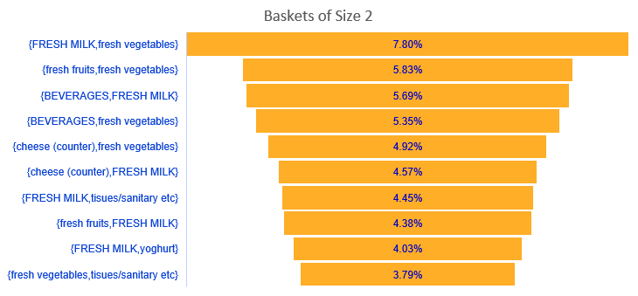
BASKET ANALYSIS
Frequent Item Sets

Slide 7
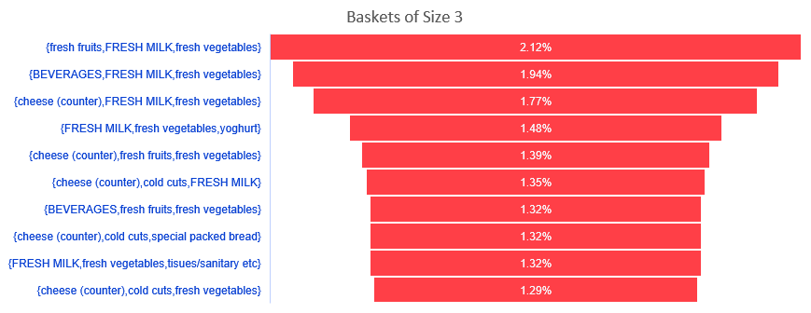
BASKET ANALYSIS
Frequent Item Sets

Slide 8
BASKET ANALYSIS
Frequent Item Sets

Slide 9
Affinity Rules
BASKET ANALYSIS
Affinity rules are if-then statements that help to show the probability of relationships between data items within large data sets in various types of databases.

Slide 10
BASKET ANALYSIS
confidence
LHS
RHS
59.82%
{cold cuts, special packed bread}
{cheese (counter)}
59.17%
{cheese (counter), fresh fruits}
{fresh vegetables}
55.14%
{cold cuts, fresh vegetables}
{cheese (counter)}
59.82%
{cold cuts, FRESH MILK}
{cheese (counter)}
Affinity Rules

Slide 11
BASKET ANALYSIS
confidence
LHS
RHS
32.20%
{hair care}
{HYGIENE - COSMETICS}
31.18%
{flour}
{sugar}
30.98%
{chocolate related sweets}
{FRESH MILK}
20.55%
{cleaners}
{laundry}
Affinity Rules

Slide 12
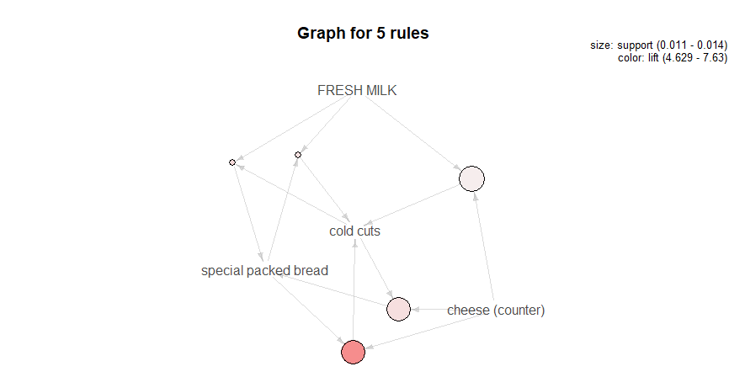
BASKET ANALYSIS
Affinity Rules

Slide 13
CUSTOMER SEGMENTATION
RFM Analysis
RFM (recency, frequency, monetary value) segmentation to target specific clusters of customers with communications that are much more relevant for their particular behaviour – thus generate much higher rates of response, plus increased loyalty and customer lifetime value.

Slide 14
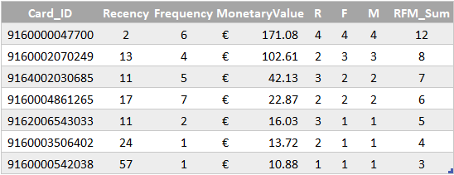

CUSTOMER SEGMENTATION
Recency, Frequency, Monetary Value - “RFM"
Card_ID
Can’t Loose Them
Champions
Loyal
Potential
Customer Value
Promising
Req. Activation

Slide 15

CUSTOMER SEGMENTATION
Require Activation
11 %
Needs Attention
8%
RFM Analysis
Promising
13%
Potential
10%
Loyal
9%
Total of 4.399 Card IDs
Champions
10%
Sum of RFM Score
0
3
4
5
6
7
8
12
Can’t Loose Them
39%

Slide 16
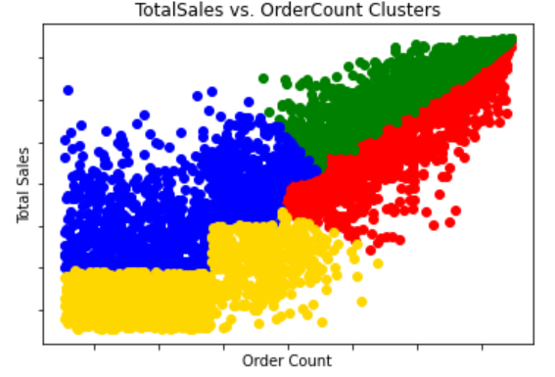
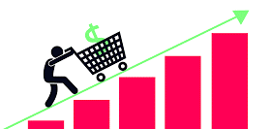
CUSTOMER SEGMENTATION
Total Sales and Frequency
1169
1002
1146
Marketing Actions
# of Card IDs
- E-mail reminders
- Discount coupons valid for purchases within 2 weeks
- Cross and up selling techniques
Opportunities Sales Funnel

Slide 17
Product Categories
CUSTOMER SEGMENTATION
We can segment customers based on the Product Categories they prefer. Based on such a classification, we can understand the Shopping Mission of the Customer, and target marketing strategies accordingly.

Slide 18
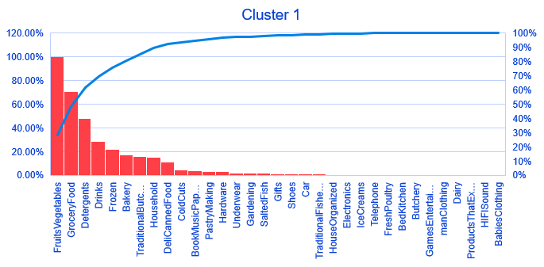
CUSTOMER SEGMENTATION
Shopping Mission:
Vegan/ Vegetarian
No Dairy Products
No Products that expire soon
Less than 10% Poultry and Fish

Slide 19
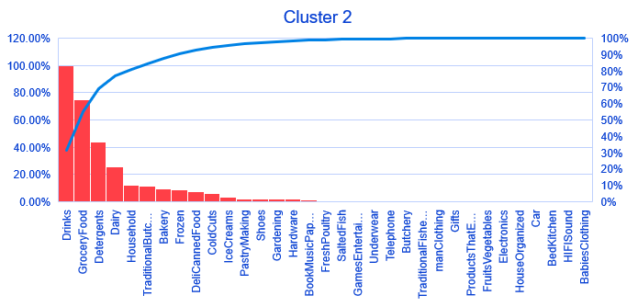
CUSTOMER SEGMENTATION
Shopping Mission:
Drinks
Drinks
Groceries
No Fruits and Vegetables

Slide 20
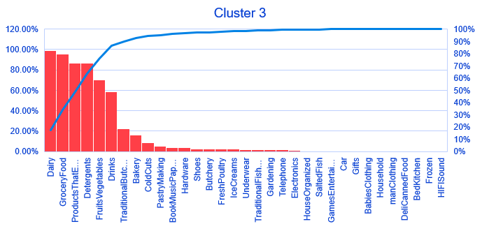
CUSTOMER SEGMENTATION
Shopping Mission:
Basic Needs
Dairy
Groceries
Products that expire
Detergents
Fruits and Vegetables
Drinks
Poultry

Slide 21
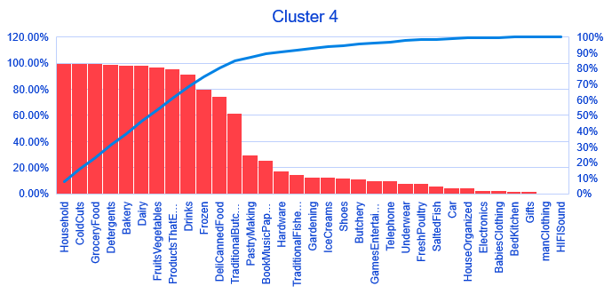
CUSTOMER SEGMENTATION
Shopping Mission:
Stock Up 1
Dairy
Household
Groceries
Bakery
Detergents
Fruits and Vegetables
Drinks
Cold Cuts

Slide 22
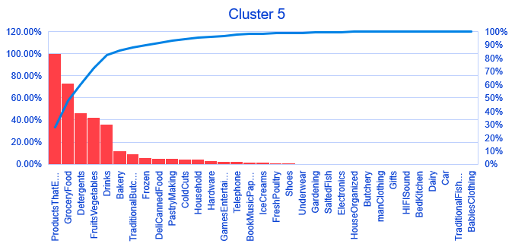
CUSTOMER SEGMENTATION
Shopping Mission:
Fresh Buy
Products that Expire Soon

Slide 23
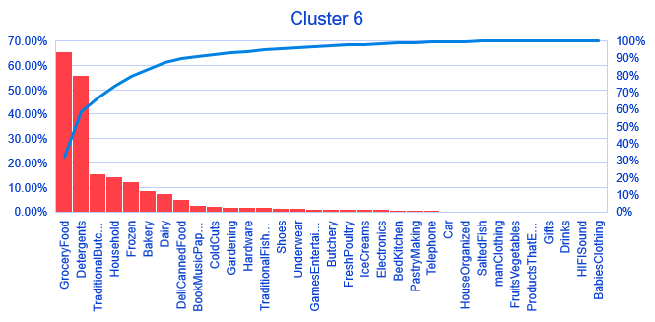
CUSTOMER SEGMENTATION
Shopping Mission:
Top Up
Low levels of basic products

Slide 24
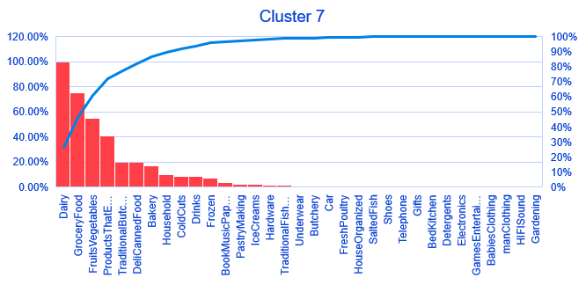
CUSTOMER SEGMENTATION
Shopping Mission:
Dairy
Dairy

Slide 25
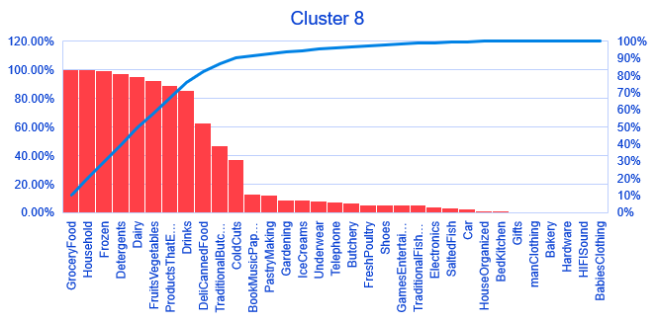
CUSTOMER SEGMENTATION
Shopping Mission:
Stock Up 2
Dairy
Household
Groceries
Bakery
Detergents
Fruits and Vegetables
Drinks
Cold Cuts

Slide 26
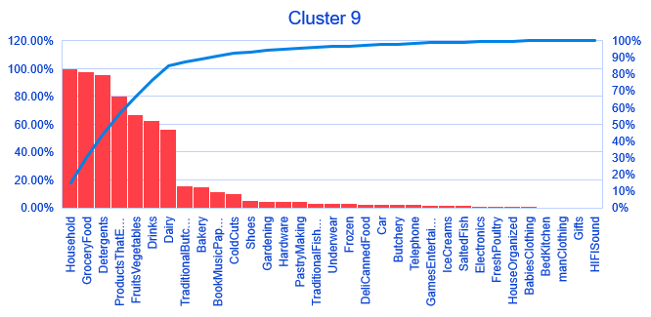
CUSTOMER SEGMENTATION
Shopping Mission:
Household
Kitchenware
Groceries
Detergents

Slide 27
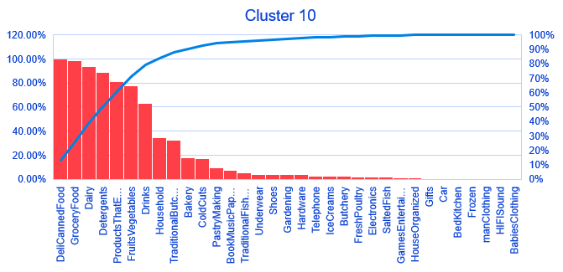
CUSTOMER SEGMENTATION
Shopping Mission:
Quick Bites
Deli and Canned Food
Groceries

Slide 28
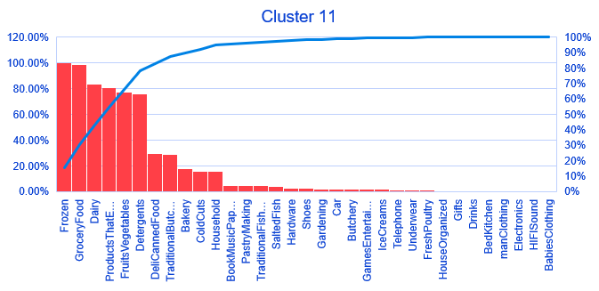
CUSTOMER SEGMENTATION
Shopping Mission:
Quick Meals (No Drinks)
Frozen Food
Groceries
No Drinks

Slide 29
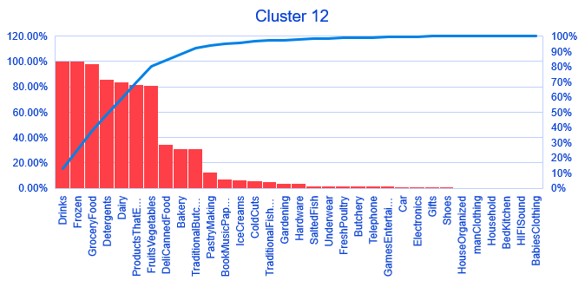
CUSTOMER SEGMENTATION
Shopping Mission:
Quick Meals (With Drinks)
Frozen Food
Groceries
Drinks

Slide 30
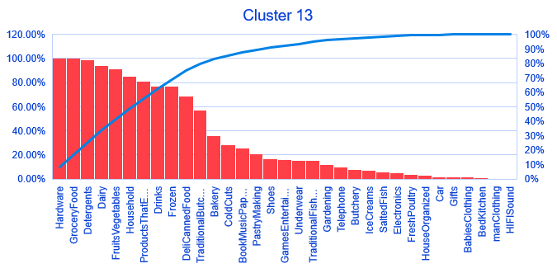
CUSTOMER SEGMENTATION
Shopping Mission:
DIY & Household
Key - Hardware
Hardware
Kitchenware
Detergents

Slide 31
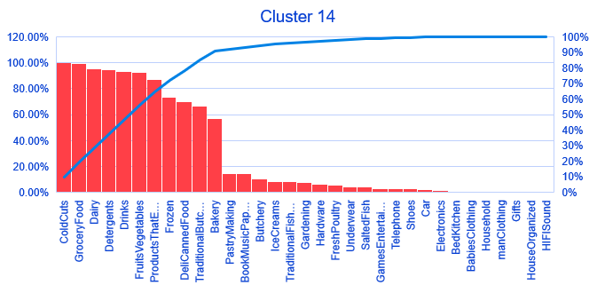
CUSTOMER SEGMENTATION
Shopping Mission:
Stock Up 3
Key – Cold Cuts
Cold Cuts
Groceries
Drinks
Fruits and Vegetables
Detergents

Slide 32
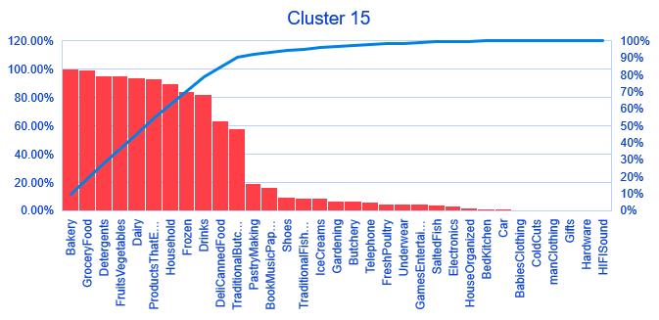
CUSTOMER SEGMENTATION
Shopping Mission:
Stock Up 4
Key - Bakery
Bakery
Groceries
Drinks
Fruits and Vegetables
Detergents

Slide 33
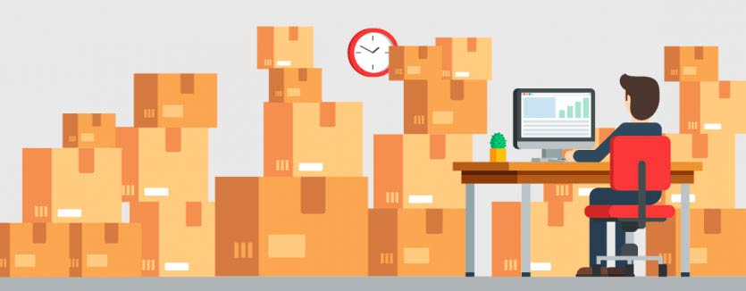
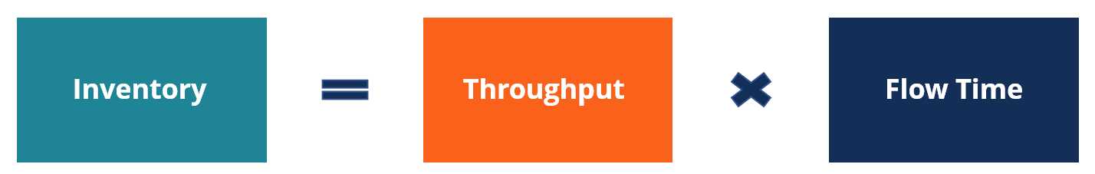
INVENTORY MANAGMENT
Inventory - the number of units that are currently contained in a business process. In operations management, inventory comes with a broader meaning and it includes all the units of the products within the operating system.
Flow Time - The time that the units spend in the business process from the beginning to the end.
Throughput – The rate at which the number of units goes through the process per unit time.

Slide 34
INVENTORY MANAGEMENT
Higher Rank Inventory needs re-stocking more frequently than Lower Ranked Inventory.
DCS | Inventory | FlowRate | FlowTime | Percentile | Rank
10/11/261/1 | 5824 | 121.3333 | 48 | 0.874474 | 4
10/11/263/2 | 250 | 5.319149 | 47 | 0.729313 | 3
10/11/264/2 | 21 | 1.75 | 12 | 0.298738 | 2
10/11/268/4 | 3 | 1 | 3 | 0.129032 | 1

Slide 35
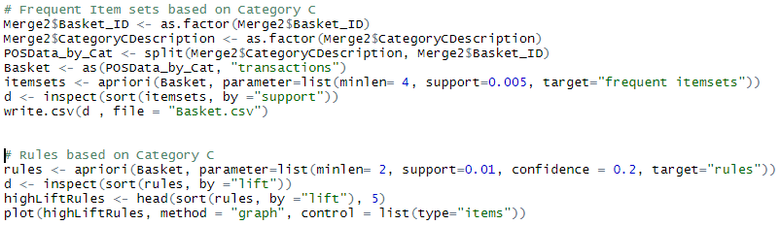
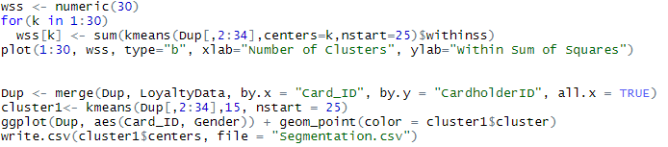
APPENDIX
For Basket Analysis, we applied unsupervised Association Analysis - performed using R Package Apriori.
For Customer Segmentation based on Product Categories, we performed K-means clustering in R.

Slide 36
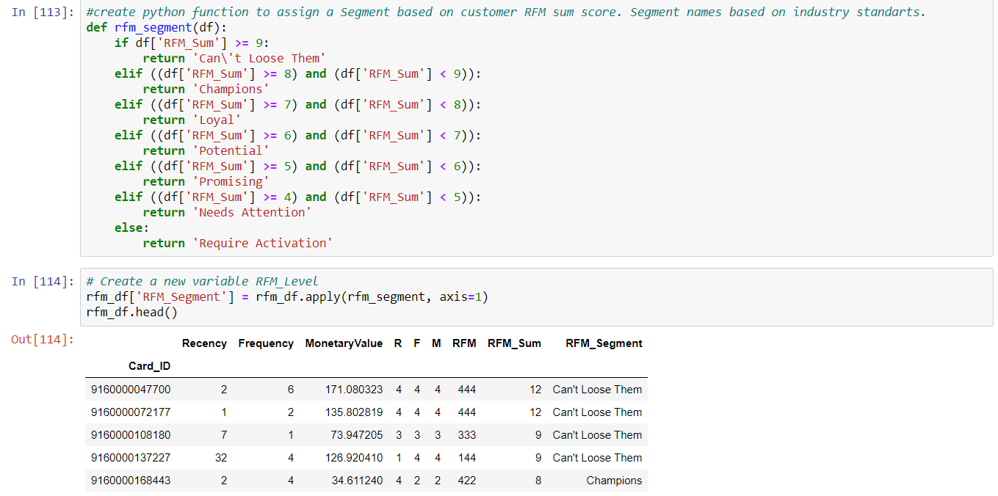
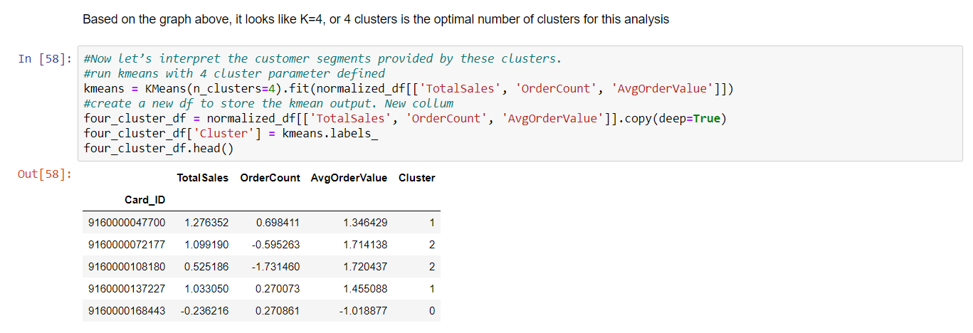
APPENDIX
For Customer Segmentation using RFM Analysis, we used Python to calculate Percentiles and Ranks of each Customer.
For Segmentation by Total Sales and Frequency, we performed K-Means clustering in Python.

Slide 37
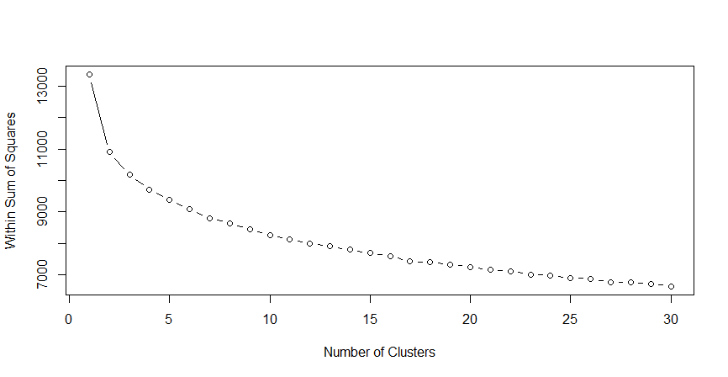
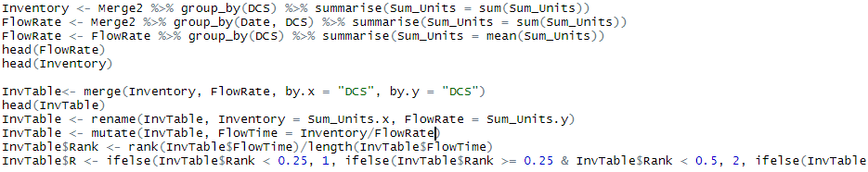
APPENDIX
Output of Elbow Analysis in R
For Inventory Management Analysis, we used R to find Ranks.

Slide 38
References
Albionresearch.com. 2020. Data Mining: Market Basket Analysis. [online] Available at: <https://www.albionresearch.com/data_mining/market_basket.php> [Accessed 14 April 2020].
Shopify. 2020. Customer Segmentation Definition - What Is Customer Segmentation. [online] Available at: <https://www.shopify.com/encyclopedia/customer-segmentation> [Accessed 14 April 2020].
SearchERP. 2020. What Is Inventory Management?. [online] Available at: <https://searcherp.techtarget.com/definition/inventory-management> [Accessed 14 April 2020].
Optimove. 2020. RFM Segmentation | RFM Analysis, Model, Marketing & Software | Optimove. [online] Available at: <https://www.optimove.com/resources/learning-center/rfm-segmentation> [Accessed 14 April 2020].
Techopedia.com. 2020. What Is Affinity Analysis? - Definition From Techopedia. [online] Available at: <https://www.techopedia.com/definition/32062/affinity-analysis> [Accessed 14 April 2020].

